Slide 1
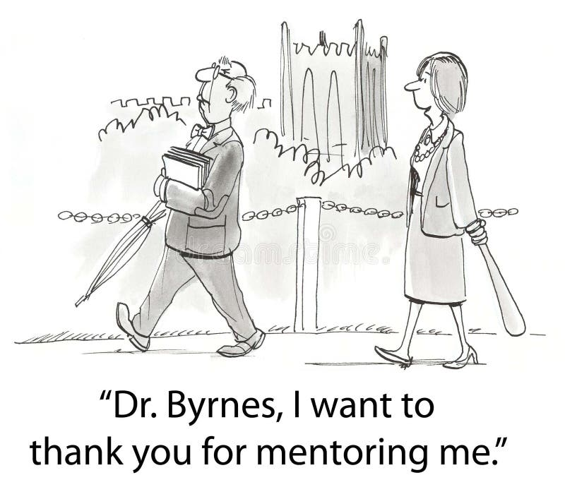
Writing For Impact
Guiding Students Toward Publication and Presentation
FALL 2026
Session 1: Whine and Shine

Slide 2
Agenda
1. Introductions
2. Overview of the workshop
3. Brief lecture
4. Breakout rooms
5. Closure

Slide 3
Workshop overview
1. October 6: Introductions & Rationale
Why engage students in publishing and conference participation? This session introduces the workshop's core content and explores the value of student publishing. We will discuss the benefits of teaching students to write and present for academic, professional, and personal development.
2. October 13: Journals
Which journals best support student success? This session explores key journals in the field and provides techniques for locating them.
3. October 20: Authorship
What are the norms and regulations surrounding authorship? This session reviews disciplinary standards and includes group discussions where participants can share their experiences and conventions around publishing.
4. October 27: Pedagogy and Funding
What pedagogical strategies do instructors use, and which ones work (or do not)? What funding opportunities exist to support student research and presentations? This session explores models of pedagogical partnerships and strategies for fostering collaborations within and across institutions. Participants will also have the opportunity to share resources for funding student travel to conferences.
ALL SESSIONS will help develop//crowd source resources and best practices for supporting student–faculty collaborations

Slide 4

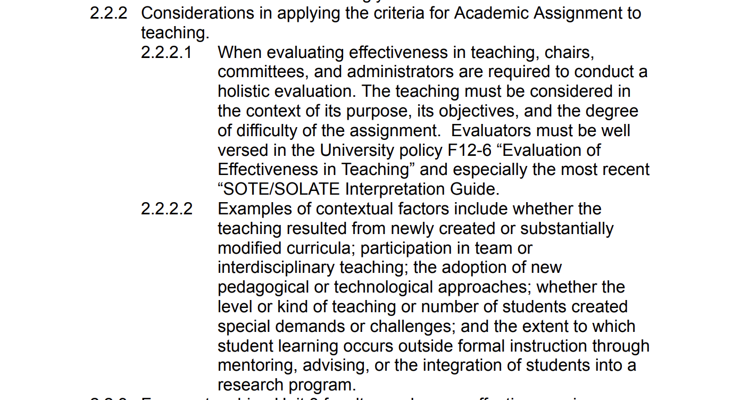
Why do we write with students?
SJSU evaluates faculty in three areas:
teaching or academic assignment:
"mentoring, advising, or the integration of students into a research program."
service
research, scholarship, and creative activity (RSCA)

Slide 5
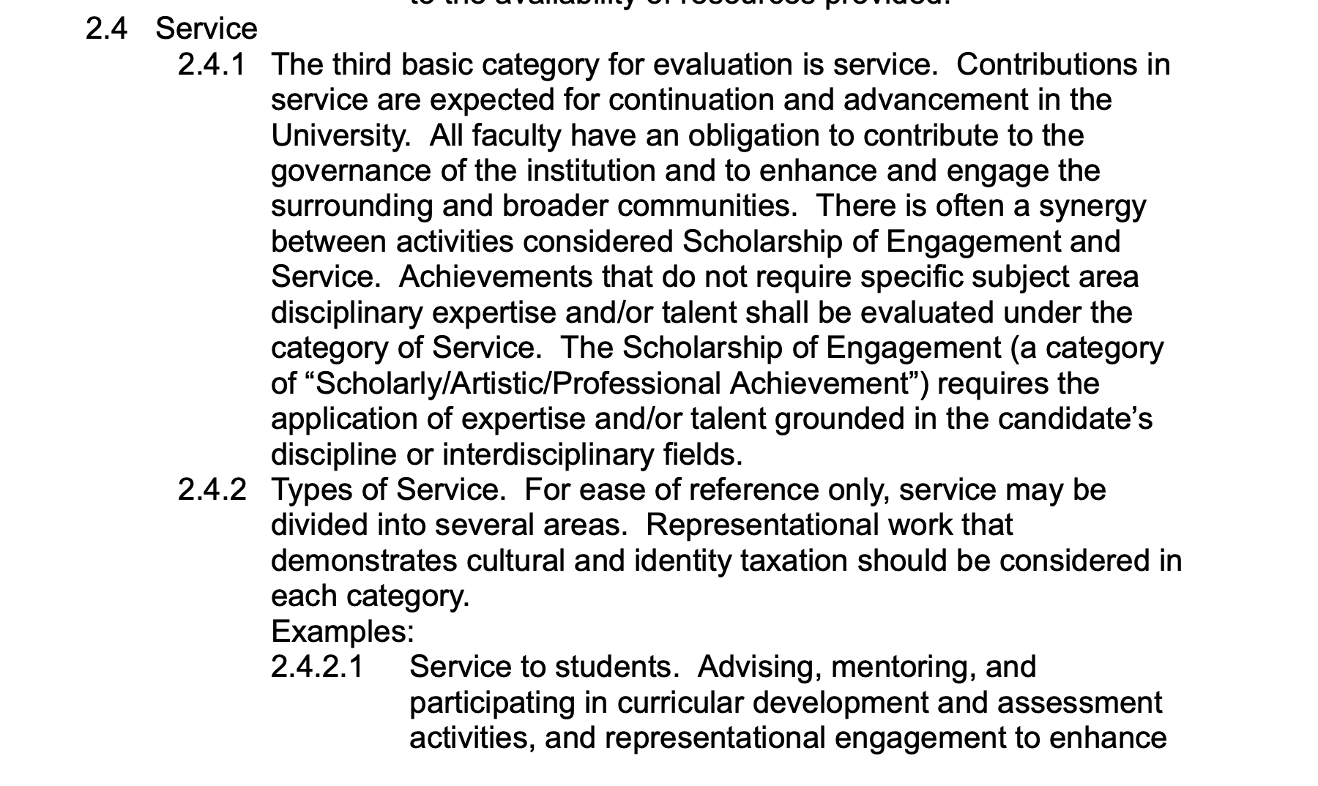
Why do we write with students?
SJSU evaluates faculty in three areas:
teaching or academic assignment
service
research, scholarship, and creative activity (RSCA)
The scholarly product itself would fall under RSCA, while the mentoring and student development involved could provide additional context for the work.

Slide 6
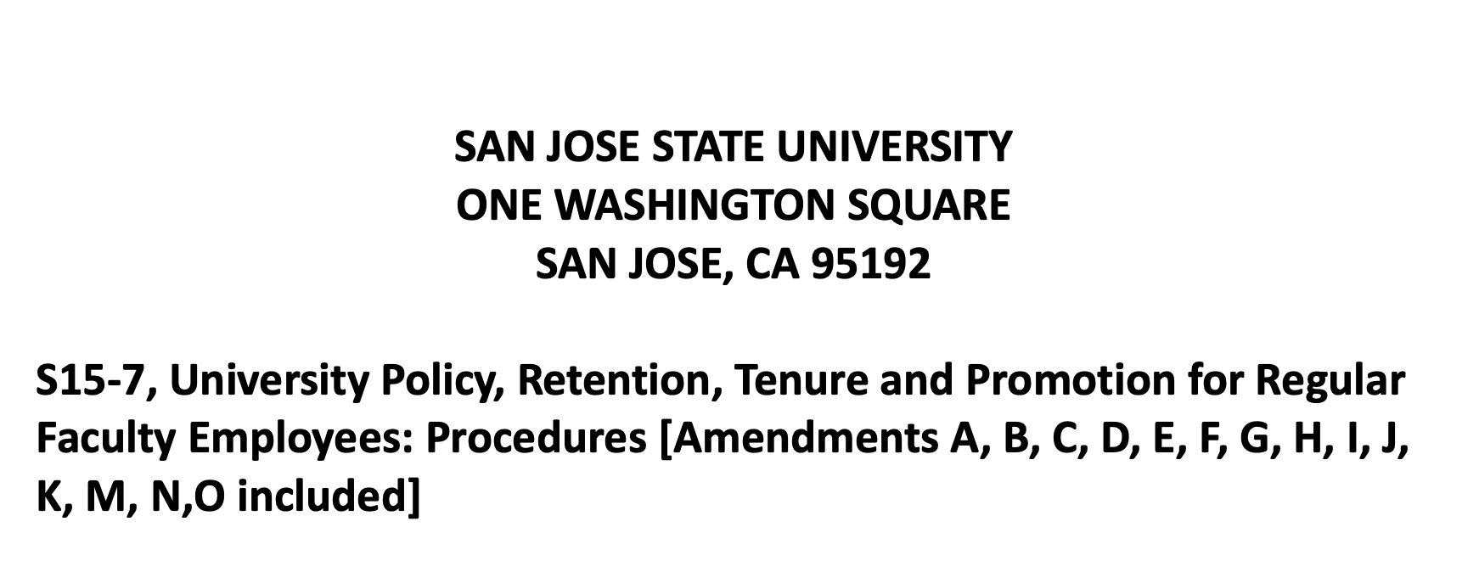
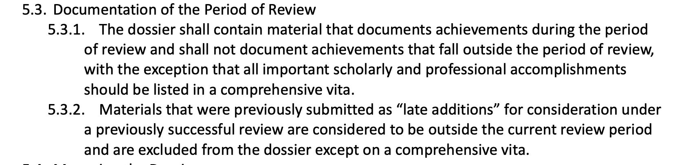
Documentation:
Make mentoring component as explicit as possible rather than just listing the resulting publication or presentation.
You could briefly describe what you did with the student, the nature of the project, and the outcome (conference presentation, publication, research experience, etc.).
S15-7 emphasizes that the review is based on the evidence included in the dossier;
Providing that context would help reviewers understand the work and its impact.

Slide 7
Break out session
Your achievements and your grievances
Show and tell how you documented your projects
Your lessons; your regrets; your suggestions
What specifically this workshop may help you improve?

Slide 8
Resources
Croud sourcing document:
https://docs.google.com/document/d/1ueiWWC18_vRnt-Yv-Dnt94_OHJqGYLaoksVoc9TcJZY/edit?tab=t.0
SJSU policies consulted:
S15-8: https://www.sjsu.edu/senate/docs/S15-8.pdf
S15-7: https://www.sjsu.edu/senate/docs/S15-7.pdf

